Slide 1

Module 6: Architectural Design
Part I
Software Engineering
School of Computing, Faculty of Engineering
Universiti Teknologi Malaysia

Slide 2

Outline
Architectural Design and Detailed Design
Architectural Design Decision
Architectural View
Architectural Pattern
  Model-View-Controller (MVC)
  Layered
  Repository
  Client-Server
  Pipe and Filter
Note: The overall contents of the slide are based on the main reference that is Sommerville (2016) with other references specified directly in respective slides (if any)

Slide 3

Objectives
To know the purpose of design and the difference between architectural and detailed design (use case realization)
To understand the architectural design decision
To know differences in architectural views and representation using UML diagrams (deployment diagram and details of component diagram)
To identify the use of different architectural patterns

Slide 4
Architectural design and detailed design
Overview

Slide 5
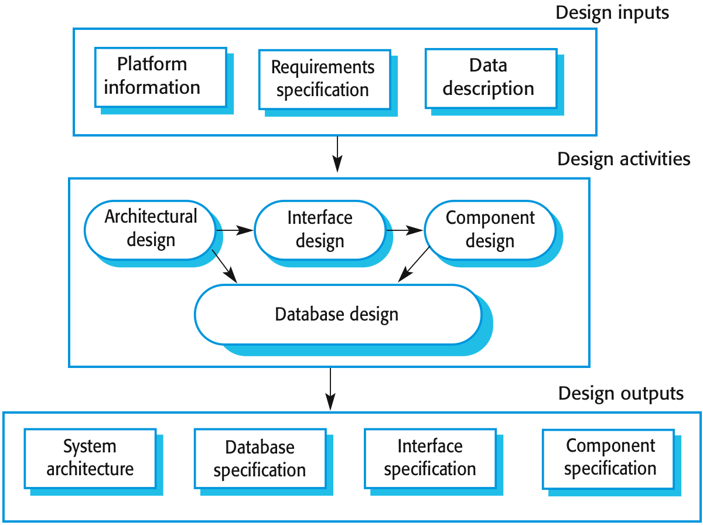
Recap on Design Stage

Slide 6
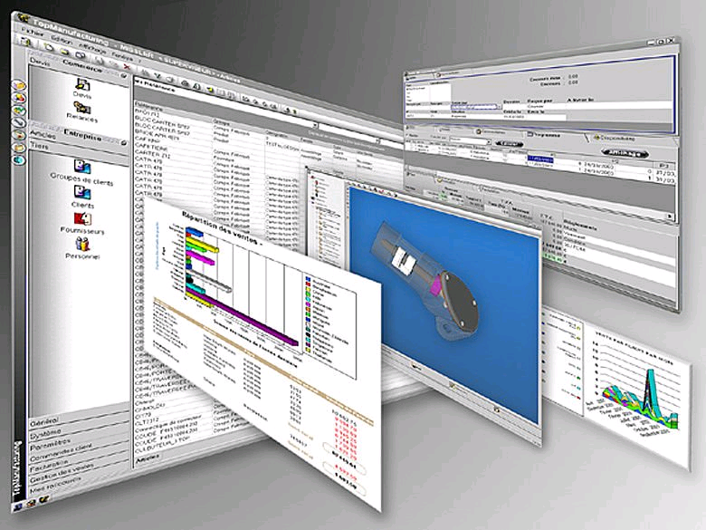
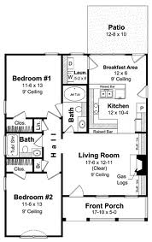
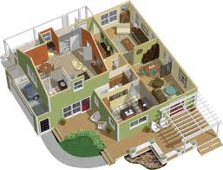
Architecture Analogy for
Software vs. House?

Slide 7
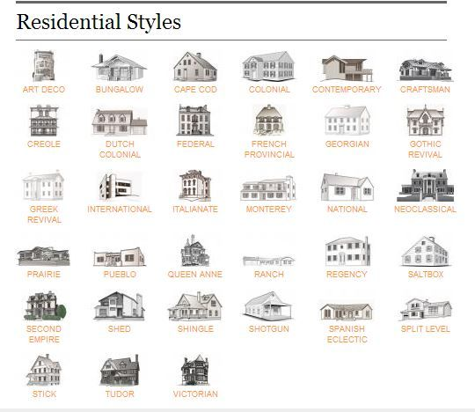
Analogy: Residential Styles

Slide 8
Design Discipline Activities
Segmented into 6 major activities:
  Design the support services architecture and deployment environment →(network course)
  Design the software architecture →focus of SE lecture
  Design the use case realizations →focus of SE lecture
  Design the database → (database course)
  Design the system and user interfaces (HCI course)
  Design the system security and controls (network security; database security)

Slide 9
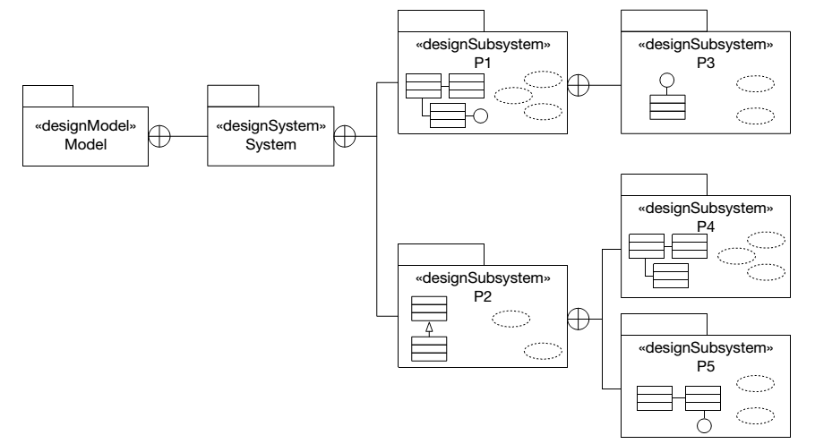
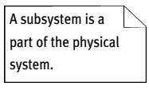
From Analysis to Design:
Design Artefacts Metamodel
Design model contains exactly one design system that contains many design subsystems (also known as “package” that can also be introduced in the analysis)
Source: Arlow and Neustadt (2002)

Slide 10
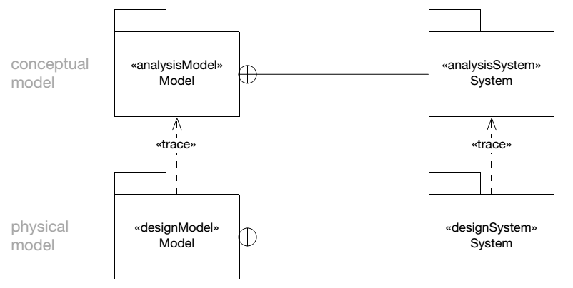
Relationships between Analysis and Design (Model and System)
There is a simple «trace» relationship between the analysis and design models – the design model is based on the analysis model, and can be considered to be just a refinement and elaboration thereof
Similarly, there is a simple, one-to-one «trace» relationship between the analysis system and the design system
Source: Arlow and Neustadt (2002)

Slide 11
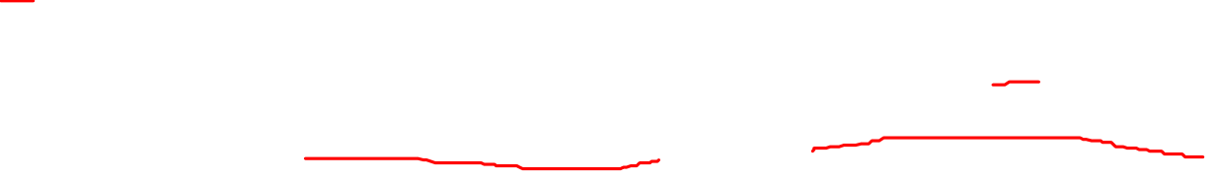
Architectural Design: Design the Software Architecture
Architectural design is concerned with understanding how a software system should be organized and designing the overall structure of that system
Architectural design is the critical link between design and requirements engineering, as it identifies the main structural components in a system and the relationships between them
The output of the architectural design process is an architectural model that describes how the system is organized as a set of communicating components

Slide 12
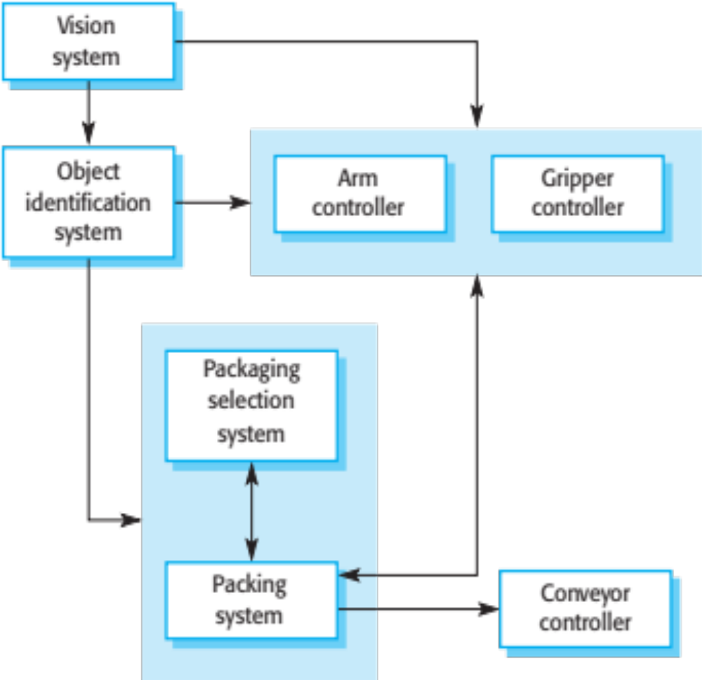
Example: Architecture of a Packing Robot Control System

Slide 13
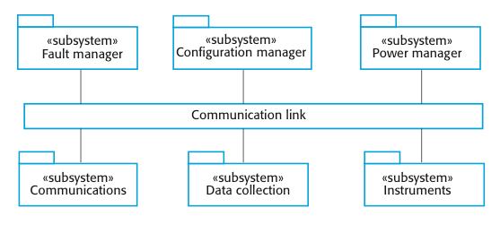
Example: High Level Architecture of Weather Station System

Slide 14
Advantages of Explicit Architecture
Stakeholder communication
  Architecture may be used as a focus of discussion by system stakeholders
System analysis
  Means that analysis of whether the system can meet its non-functional requirements is possible
Large-scale reuse
  The architecture may be reusable across a range of systems
  Product-line architectures may be developed

Slide 15
Architectural Representations
Simple, informal block diagrams showing entities and relationships are the most frequently used method for documenting software architectures
But these have been criticised because they lack semantics, do not show the types of relationships between entities nor the visible properties of entities in the architecture
Depends on the use of architectural models, the requirements for model semantics depends on how the models are used

Slide 16
Box and Line Diagrams
Very abstract - they do not show the nature of component relationships nor the externally visible properties of the sub-systems
However, useful for communication with stakeholders and for project planning

Slide 17
Use of Architectural Models
As a way of facilitating discussion about the system design
  A high-level architectural view of a system is useful for communication with system stakeholders and project planning because it is not cluttered with detail
  Stakeholders can relate to it and understand an abstract view of the system, then discuss the system as a whole without being confused by detail
As a way of documenting an architecture that has been designed
  The aim here is to produce a complete system model that shows the different components in a system, their interfaces and their connections

